Slide 1
Laudato Si’ and Care for Creation: Where Next :
SEEING
October 2016
Maria Elena Arana CAFOD
Notes:
Our Ref: 275~5
The Reverend T O'Brien
Our Lady Immaculate & St Andrew
Presbytery
16 Nightingale Road
HITCHIN
Hertfordshire
SG5 1QS
Arrive 9am
Set up stall and IT

Slide 2

Notes:
This session will cover:
What do you see?
What does the Pope see?
What do CAFOD and some of our partners see?
Buzz for 2 minutes with neighbour – what do you see as the greatest sign of hope and the greatest sign of despair in our world today? Take a few examples.... (5 mins total)
We have heard a few examples of what you see, but what does Pope Francis see? Let’s have a quick look at what he says in Laudato Si’.....

Slide 3
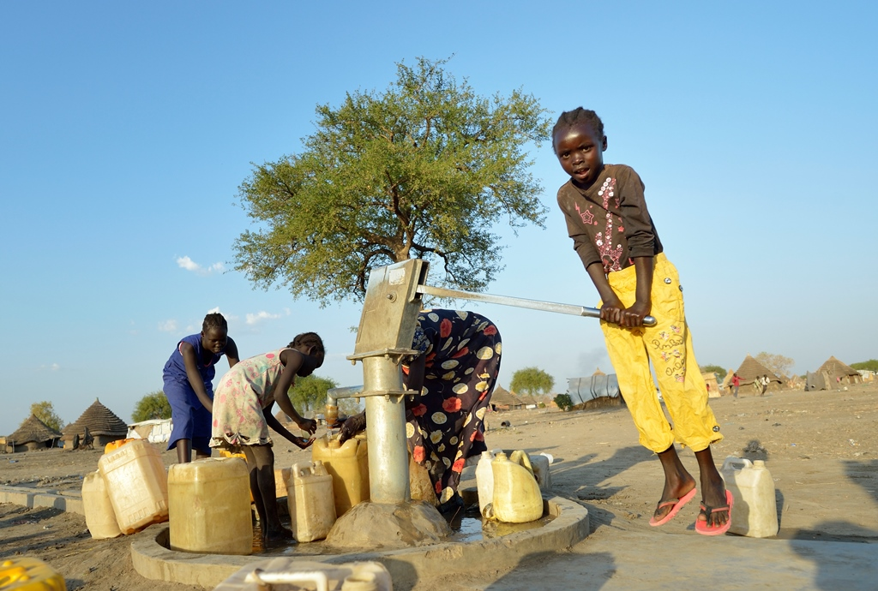
The cry of the earth and the cry of the poor
Notes:
In the first chapter What is happening to our common home, Pope Francis gives an overview of some of the symptoms of the crisis which he sees that humanity and creation are experiencing –
pollution, waste, the throwaway culture, climate change, loss of biodiversity, global inequality and the decline of the quality of human life and the breakdown of society.
For the Pope, the deterioration of the environment and the deterioration of society are inextricably linked, and both affect the most vulnerable on the planet (#48).
We need to open our eyes, and see, but also open our ears and listen, so we can be receptive to both the cry of the earth and of the poor (#49).

Slide 4
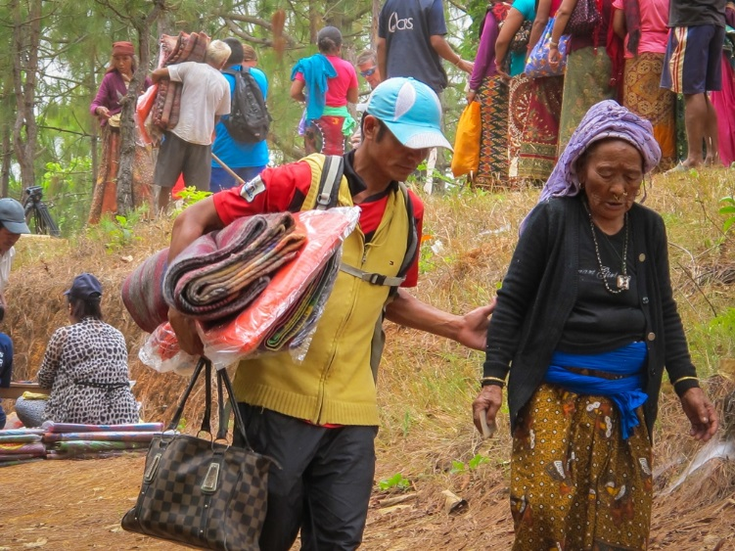
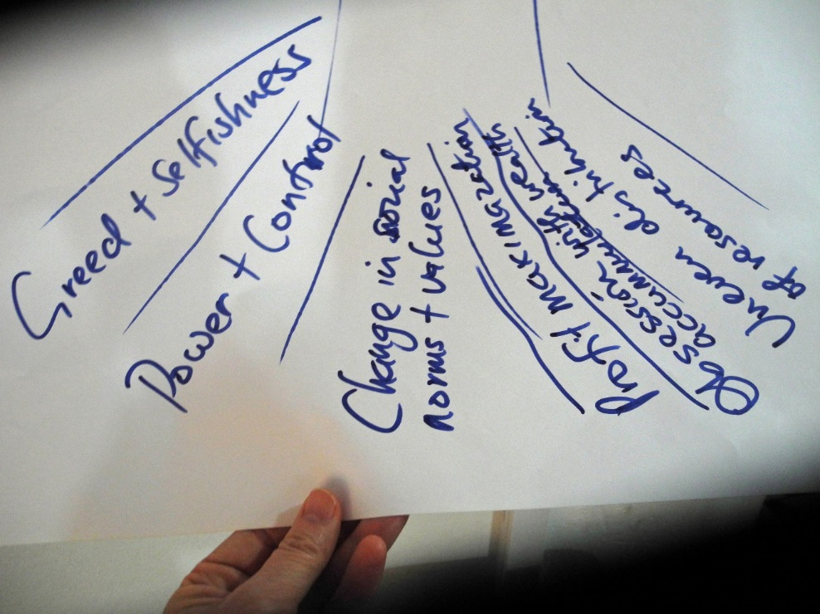
The human roots of the crisis
Notes:
In chapter three, the human roots of the ecological crisis are examined.
The Pope acknowledges that there have been great technological developments, but these have not always gone hand in hand with human responsibility and integral values (#105).
We live in a culture where there seems to be an unquestioned understanding that growth is unlimited and should be pursued at all costs.
This he suggests, has come about through humans putting themselves at the centre – their own needs, desires and conveniences.
(The flipchart taken from a workshop on Laudato Si’ in Sierra Leone)

Slide 5
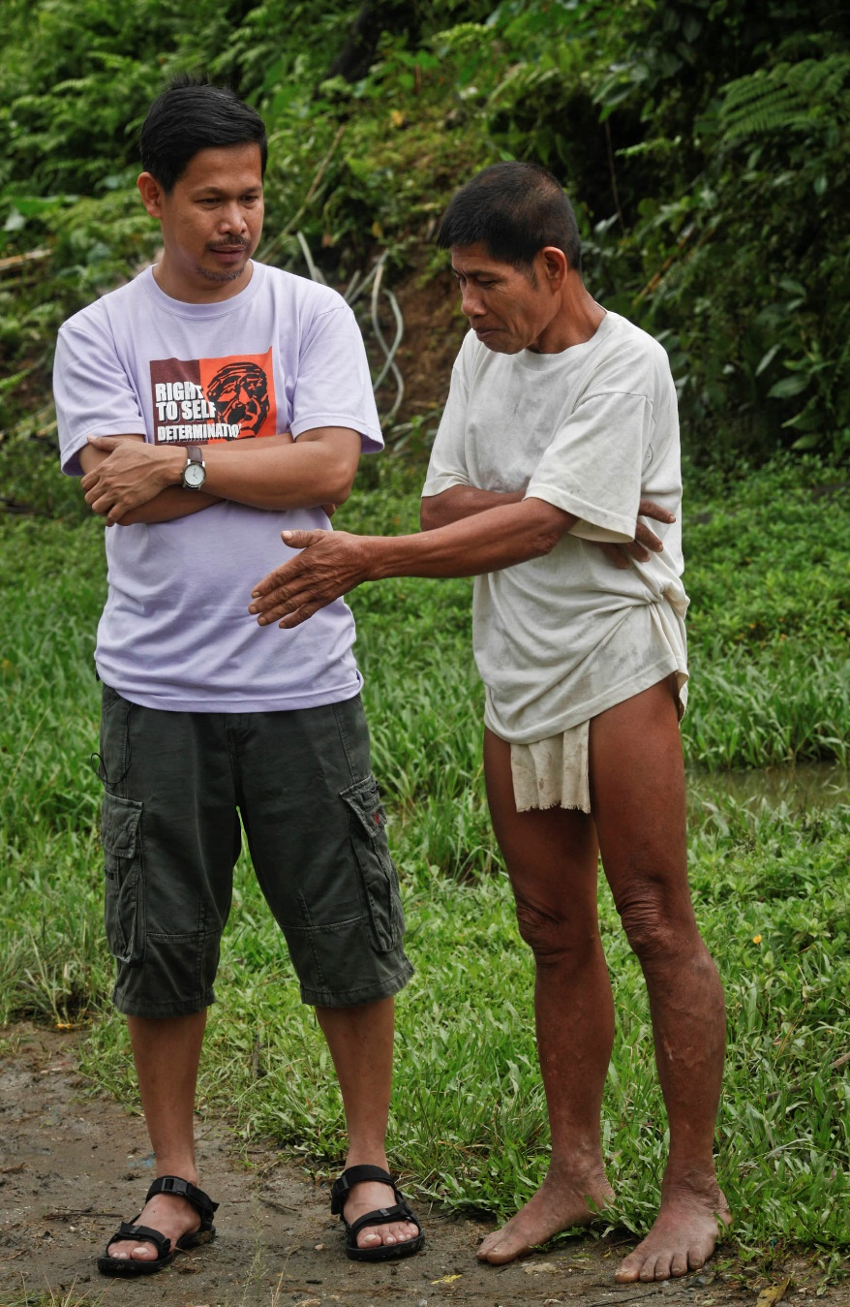
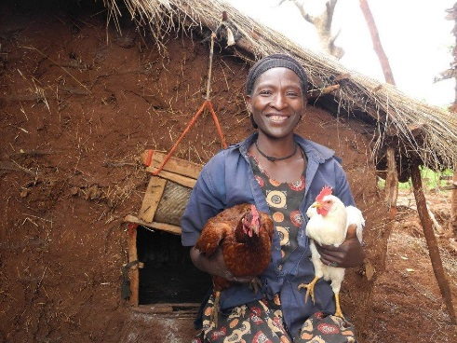
All created things are part of a network
The forest is where God is….we have no need for a church!
Fr Edu Gariguez from the Philippines
Notes:
Chapter four will be discussed by Edward later this morning and focuses on integral ecology – the fact that everything is interconnected and interrelated, and that all created things are part of living network.
Fr Edu came from the Philippines- CAFOD’s key humanitarian partner- director of Caritas Philippines – he even spoke here in summer 2015 at our Lady of Victories. For part of his working life, he worked with indigenous peoples in the mountains of the Philippines. He spoke of another priest suggesting to an indigenous community that they build a Church – and they laughed – the forest is where God is, they said.

Slide 6
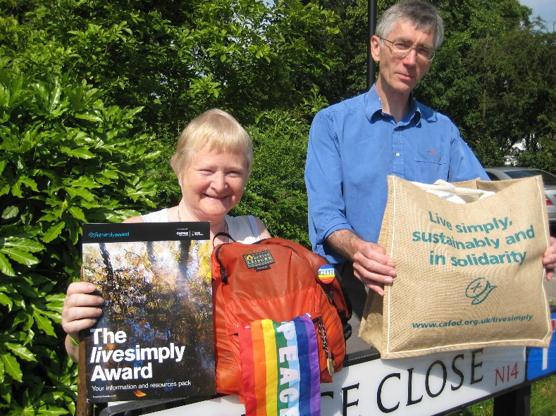
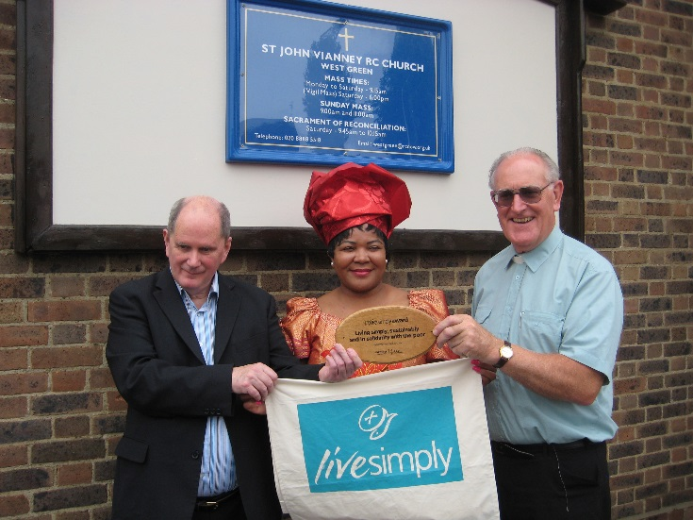
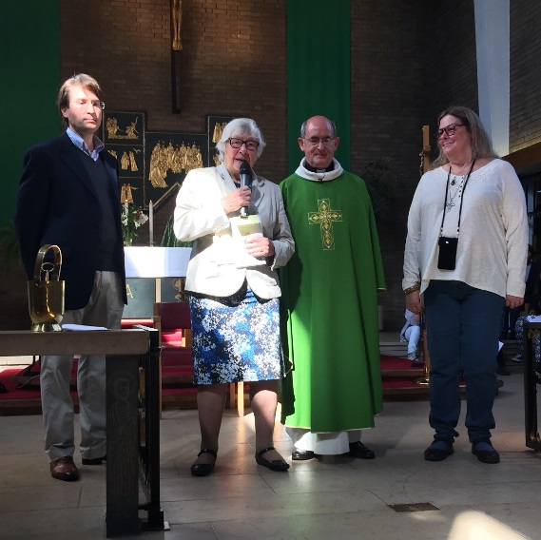
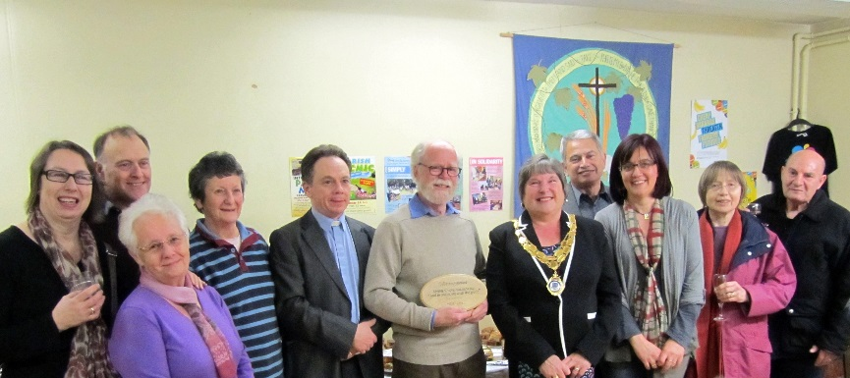
A common plan
Notes:
Again Edward will be speaking about Ch 5 – Pope Francis speaking about a common plan!
Like the plans of the Westminster parishes who have created a plan for living more simply, sustainably and in solidarity with those who are poor.
And you will be pleased to hear that Westminster Diocese along with 15 others (out of 22) has switched to a renewable energy tariff.

Slide 7
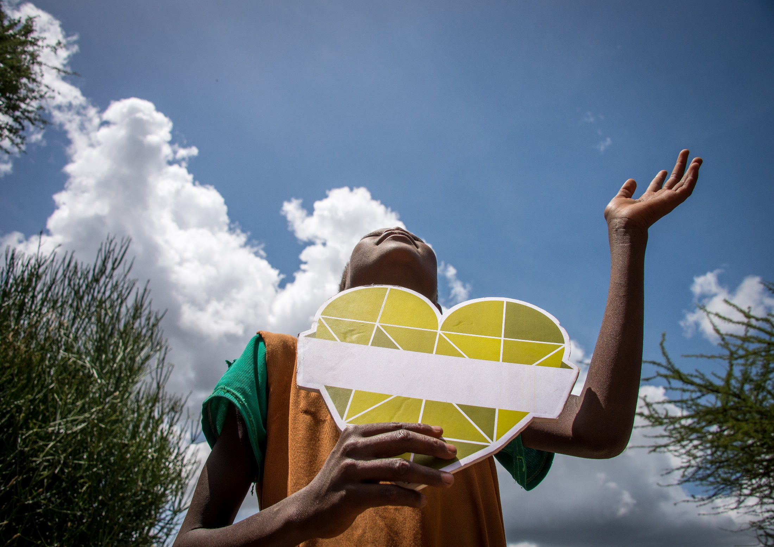
Living Mercifully
Notes:
Pope Francis also sees that our spirituality needs to have mercy at its heart, since mercy is the essence of God.

Slide 8
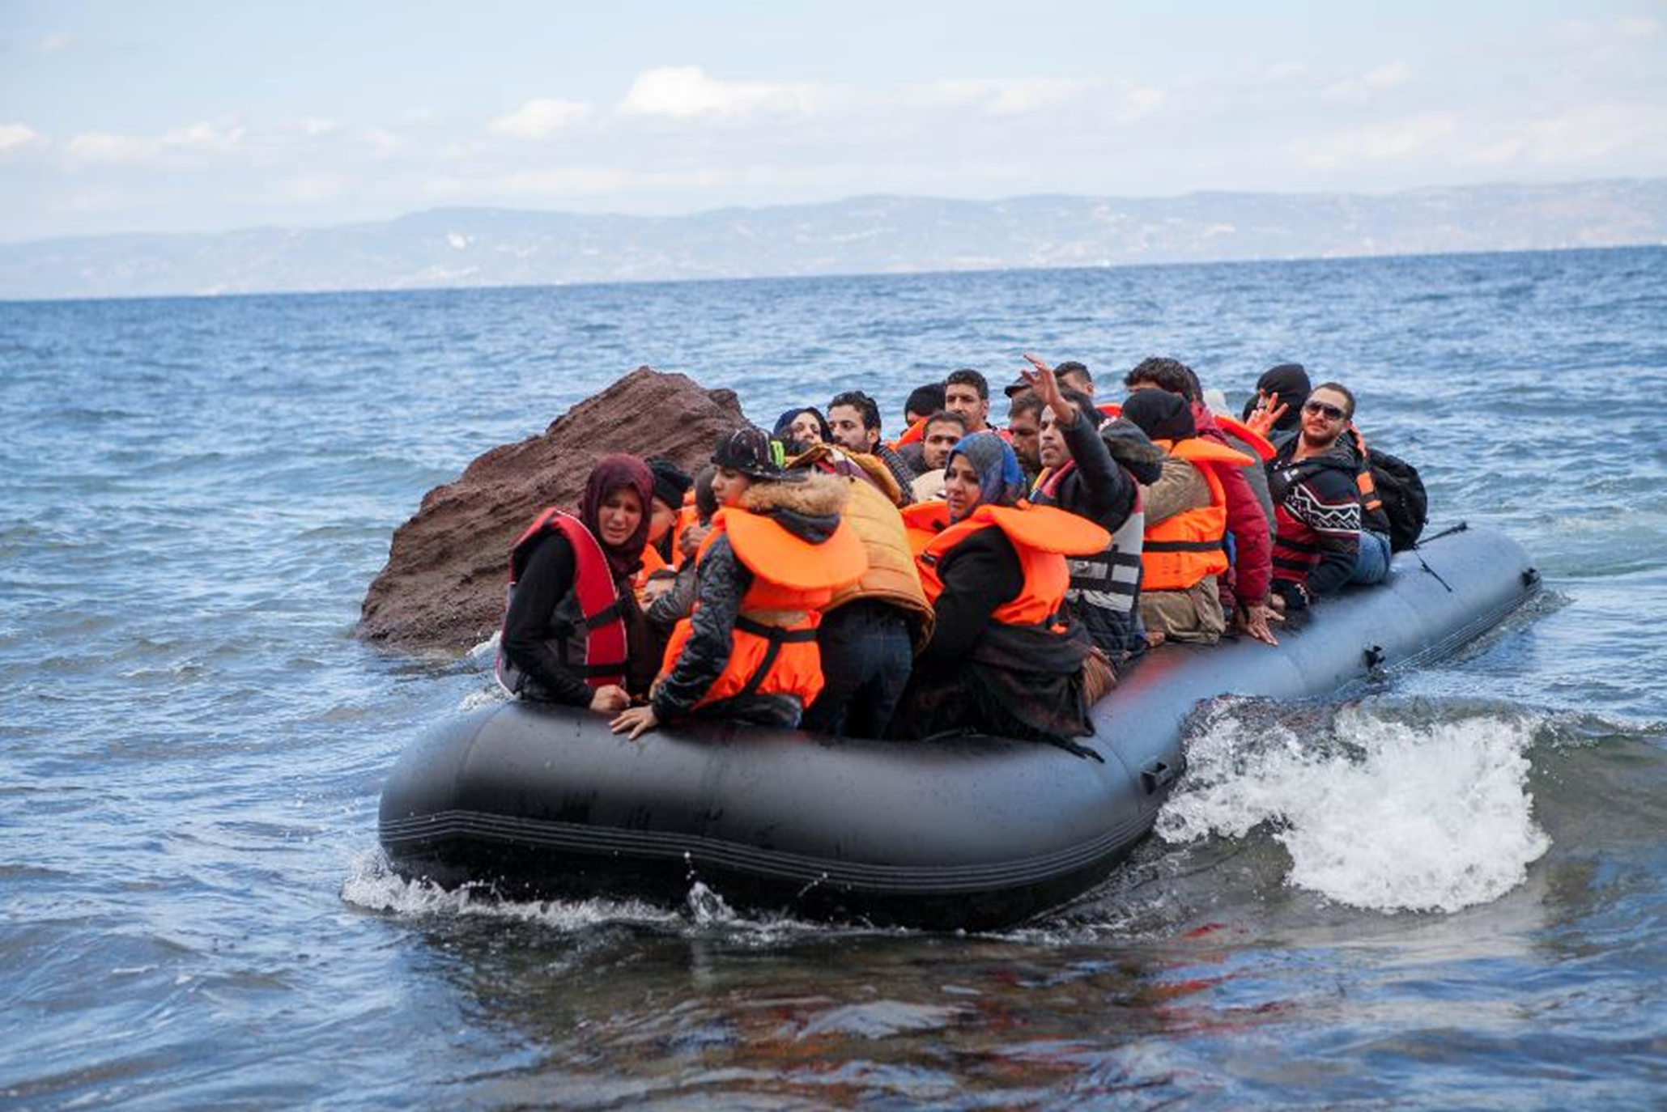
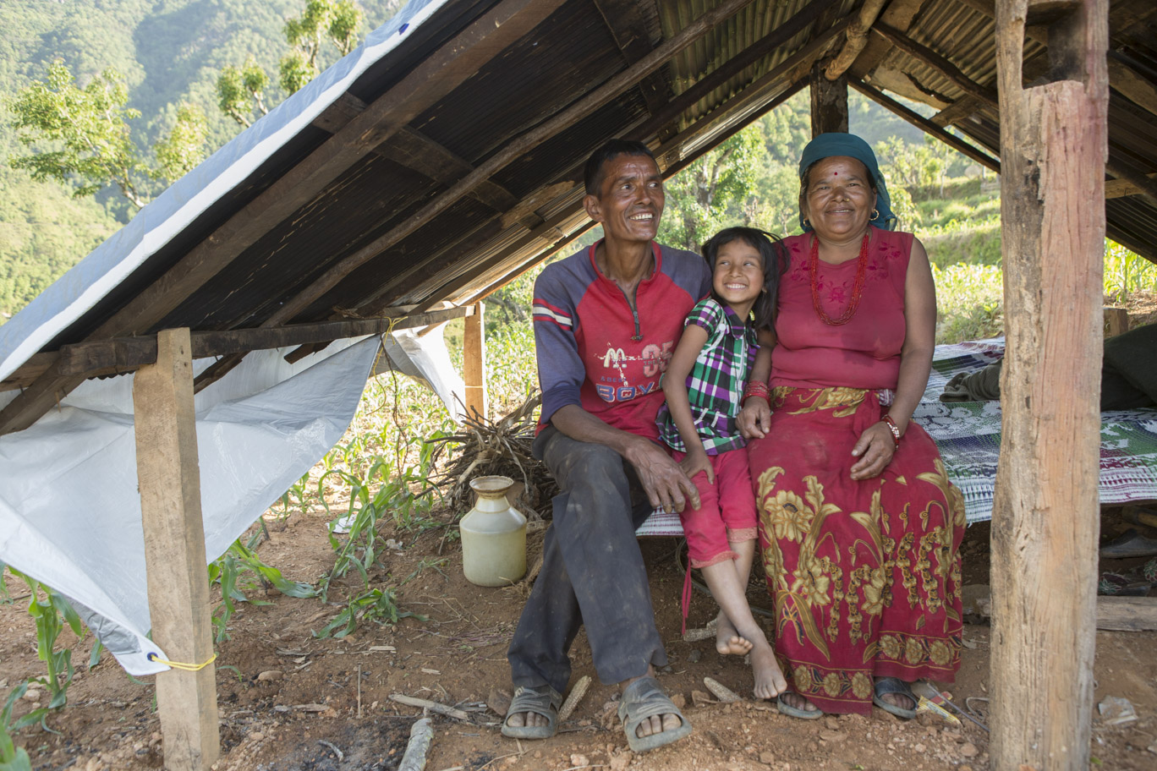
“to proclaim the mercy of God, the beating heart of the Gospel” (AL #309)
Notes:
So, in all our thoughts and actions we are called “to proclaim the mercy of God, the beating heart of the Gospel” (AL #309).
We cannot be credible witnesses if we lack mercy (AL #310); it is a fundamental part of our faith.
Our spirituality therefore needs to be integral, it needs to be consistent with the way we live our lives....

Slide 9
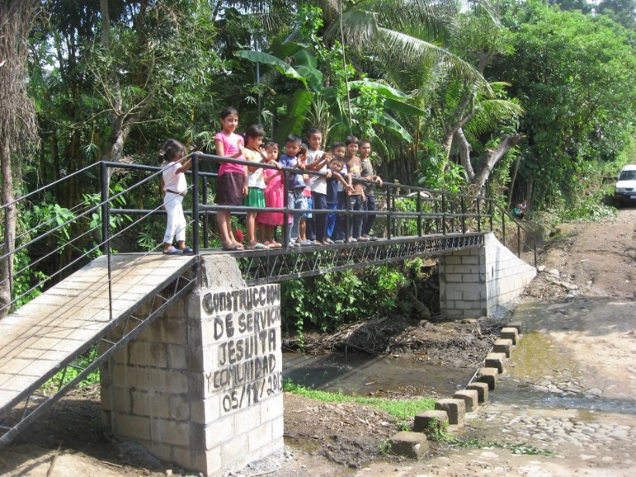
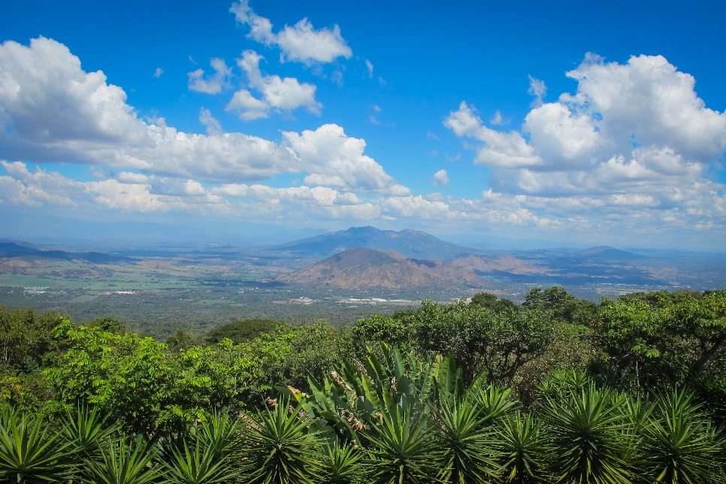
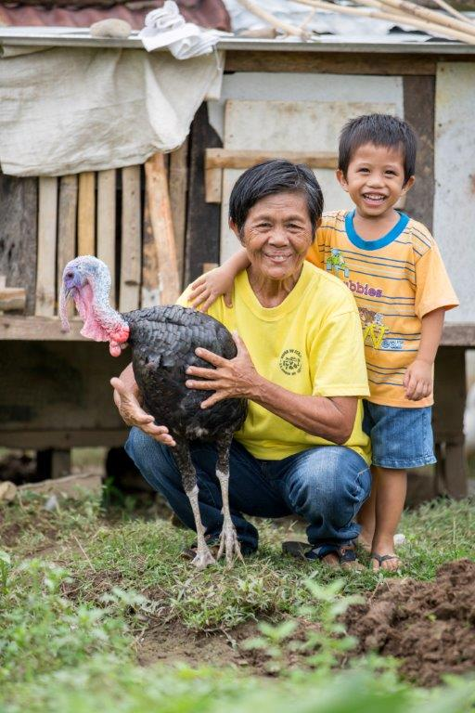
Integral Spirituality
“the teachings of the Gospel have direct consequences for our way of thinking, feeling and living” (LS #216)
“the effects of our encounter with Jesus Christ becomes evident in our relationship with the world around us”
(LS #217)
Notes:
This is what Pope Francis sees, but what about our CAFOD partners? What do they see from where they stand?
You are no doubt aware that people they work alongside are experiencing extreme weather conditions of droughts and no rain, to terrible flooding.
The Pictures are from El Salvador where we work with a poor community in Puentecitos that experiences too long rainy seasons that cuts off the community from the main road and the School by 12 feet of water
The bridge was built by the community with the support of CAFOD’s Jesuit partners. Previously the kids were climbing trees to get across to go to School
Over the last year, we have asked partners in Sierra Leone, Ethiopia, Columbia, Bangladesh and the UK what they saw as helping and hindering progress and development.
They did their reflections in conversation with Laudato Si’.
It was notable that five major topics emerged across all workshops in response....

Slide 10

technology, politics, urbanisation, economics and culture& nature.
Notes:
So key topics that these partner workshops came up with were technology, politics, urbanisation, economics and culture & nature.

Slide 11
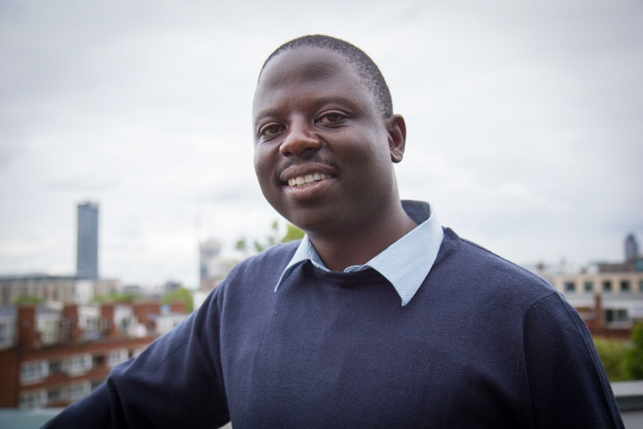
Redefining Progress with Laudato Si’: Takura Gwatinyanya and Caritas Harare
Notes:
In Zimbabwe, 45% of rural people have no access to safe water and sanitation and 60% of the water supply infrastructure is in disrepair. Lack of clean water and sanitation lead to illness with diarrhoea being a big killer especially in children under five. Drought conditions, made worse by climate change, make getting water increasingly difficult. “We walk close to a mile to this unprotected well which is a disused mine pit. It’s our only source since all the boreholes are broken down,” says Mercy, 29, mother-of-two.
Manual boreholes and bush pumps are often too heavy for women who walk long distances every day. CAFOD is helping by providing solar powered water pumps and piped water. Over 35,000 people in seven areas have received CAFOD support through the solar powered water scheme which provides clean water for drinking and watering crops and reduces the workload of women. They say, “Although fetching water still remains our responsibility, we now do it gracefully. It’s now easier as compared to the borehole. We spend less time and the taps are closer to our homes.”
Now his bishop and his organisation Caritas Harare – after Takura’s July visit to CAFOD and England and Wales has been asked to create a plan to incorporate Laudato Si’ into the future work plan for Laudato Si’. To look at ways to inspire and activate parishes and volunteers within his diocese.

Slide 12
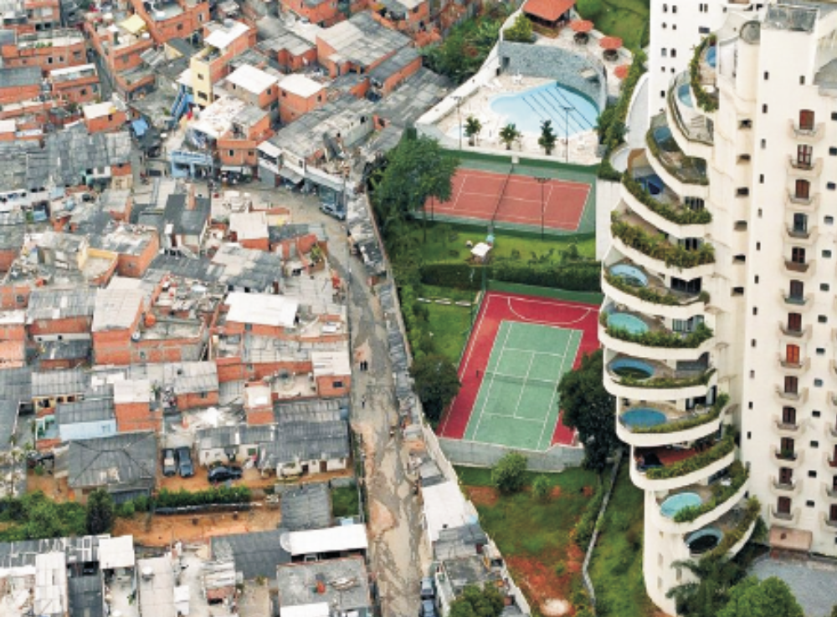
Notes:
Does anyone recognise this Slide? What does it show? Talk about disparity rich and poor in Brazil. Huge migration to the cities . People Forced off land and look for work in cities
In São Paulo 3M people live in favelas, one million in cortiços (tenements) and almost 3 million in precarious housing. 15,000 people live on the street.
While Pope Francis sees politicians as key drivers for change, CAFOD partners were far more sceptical about politicians’ roles.
Where the Pope underlines the structural issues behind urbanisation and violence, participants focused on the day-to-day problems city dwellers suffer due to insecurity and violence; however, they also pointed out the opportunities that cities provide to fulfil people’s dreams.
With regard to economics, participants agreed with the Pope about the need for urgent change.
However, different approaches for achieving future change emerged: one involves complete and immediate change; the other is a more gradual–though still radical–approach.
CAFOD work in Brazil supports Indigenous communities in the Country and our urban work communities in precarious conditions in large cities

Slide 13
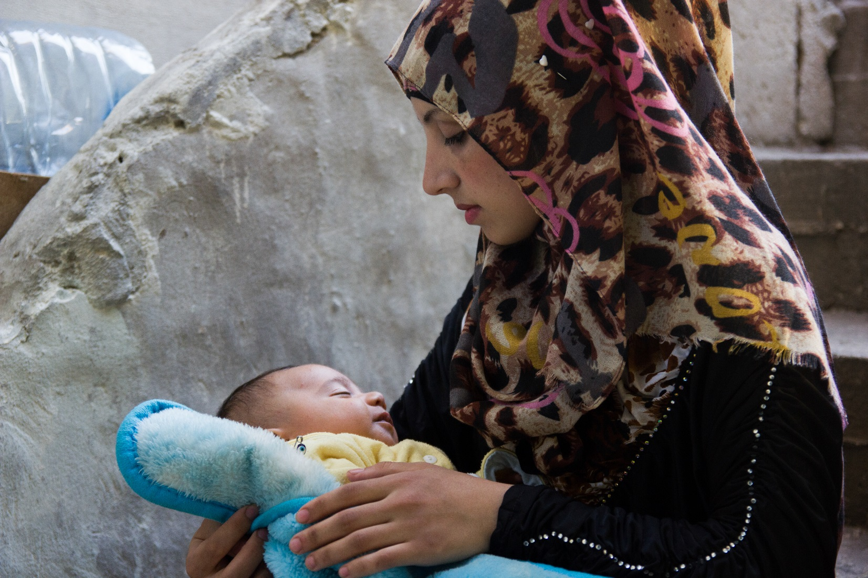
Gender
Notes:
In terms of culture, participants agreed with and added to the Pope’s analysis of the devastating effects of a consumerist and individualistic culture, as well as the threat from a global culture which does not respect diversity.
However, a key difference rapidly became evident under the theme of culture: the link between gender equality and development.
Whilst for participants across all workshops gender equality was an absolutely vital element of sustainable development and integral ecology, this topic is completely absent from Laudato Si’.

Slide 14
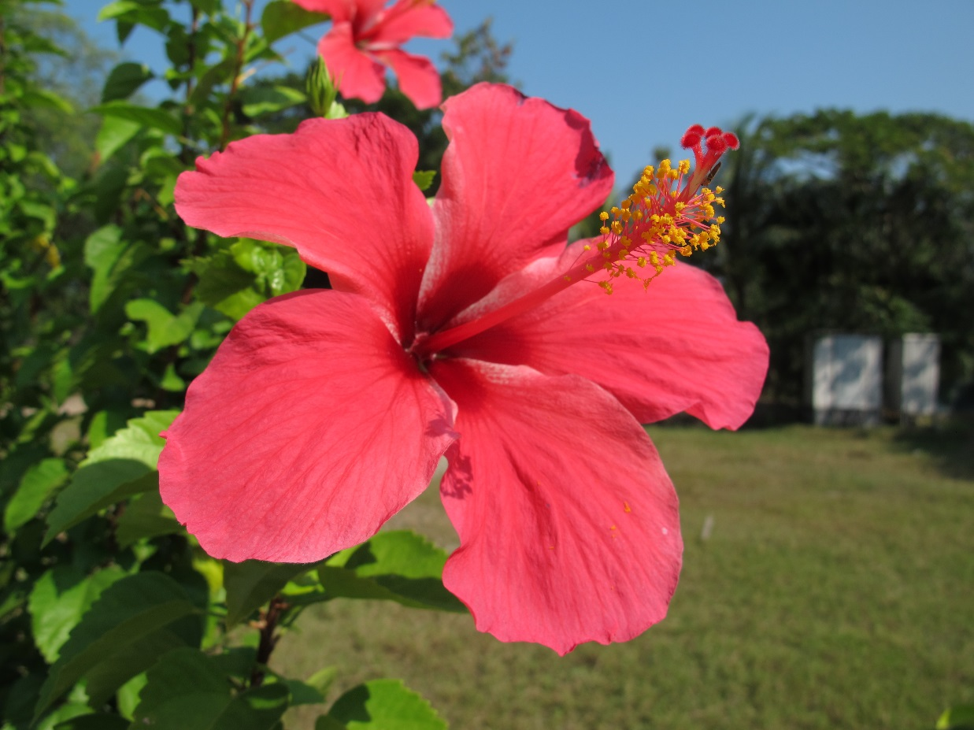
Time
Notes:
Once the question of what helps or hinders development had been analysed by our partners,
the next fundamental step was to decide what we must do differently in order to address the current crisis outlined so clearly in Laudato Si’.
It is illuminating to acknowledge how important time is in this regard for Pope Francis and for all of CAFOD’s partners.
Unanimously, they felt we needed more time for personal and community reflection on how we relate to each other and to nature;
more time to discuss what is the best way of moving forward; and, strikingly, more time for contemplation, since we need to slow down if we are to re-define our priorities, plans and development programmes.

Slide 15
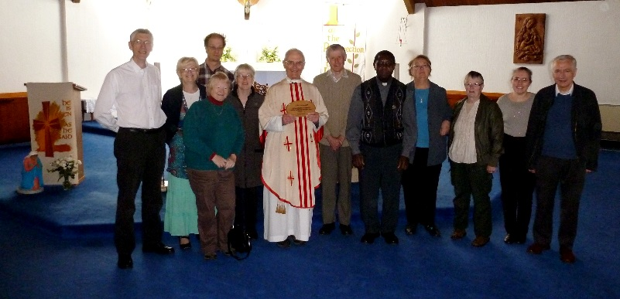
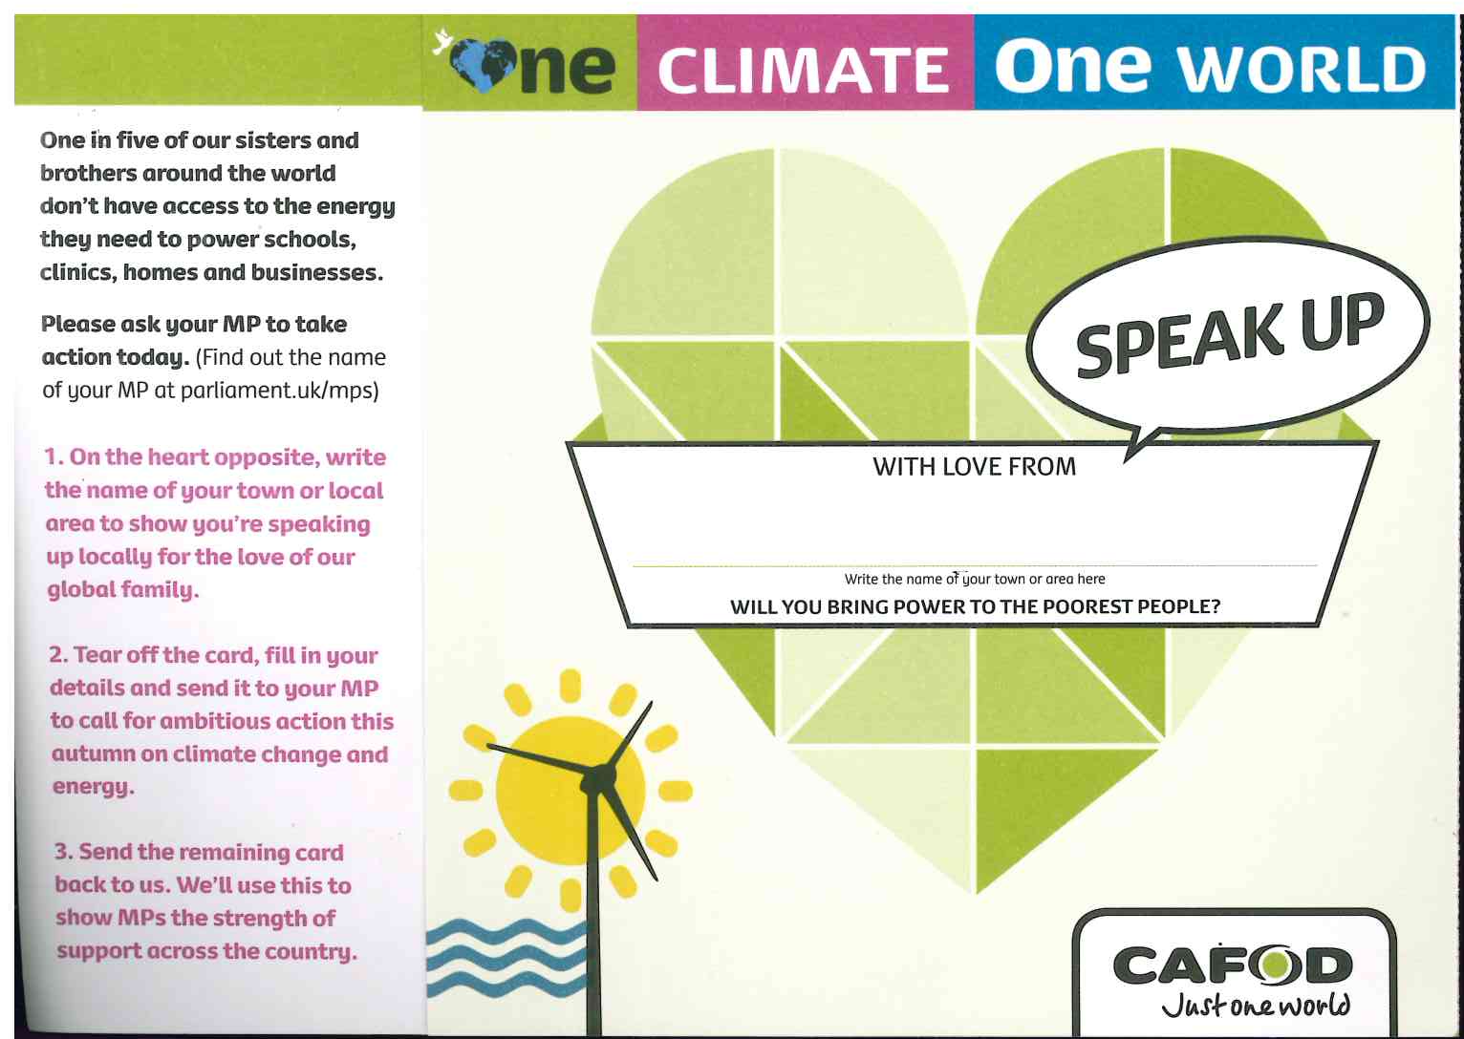
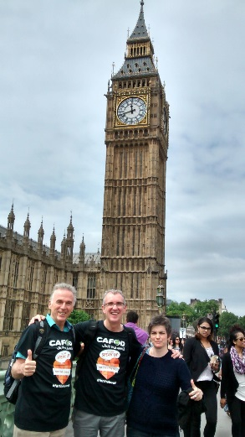
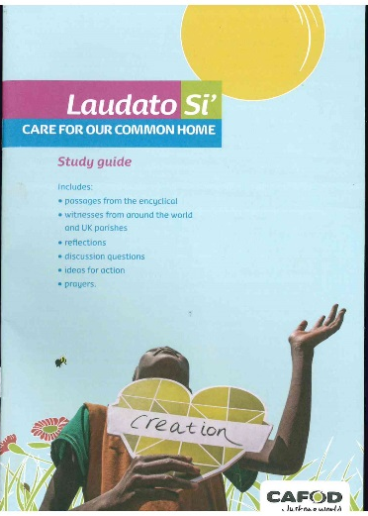

Here in the UK
Notes:
You who are Our partners here in the UK have also been reflecting with us too.
Here in the Diocese many have being doing the CAFOD Laudato guide over a series of weeks. I know of 80 in a parish locally regularly met across Lent in Harpenden
Many of you here have chosen to switch to Green Energy some on the CAFOD ecotricity deal. The Diocese and 16 others have switch too.
I know many of your either met with their MP in June 15 or have registered to do so this October as part of speak up local lobby
And 4 Parishes in Westminster have already obtained the Live Simply award
Others working towards the award , which Anne will talk about here in a moment

Slide 16
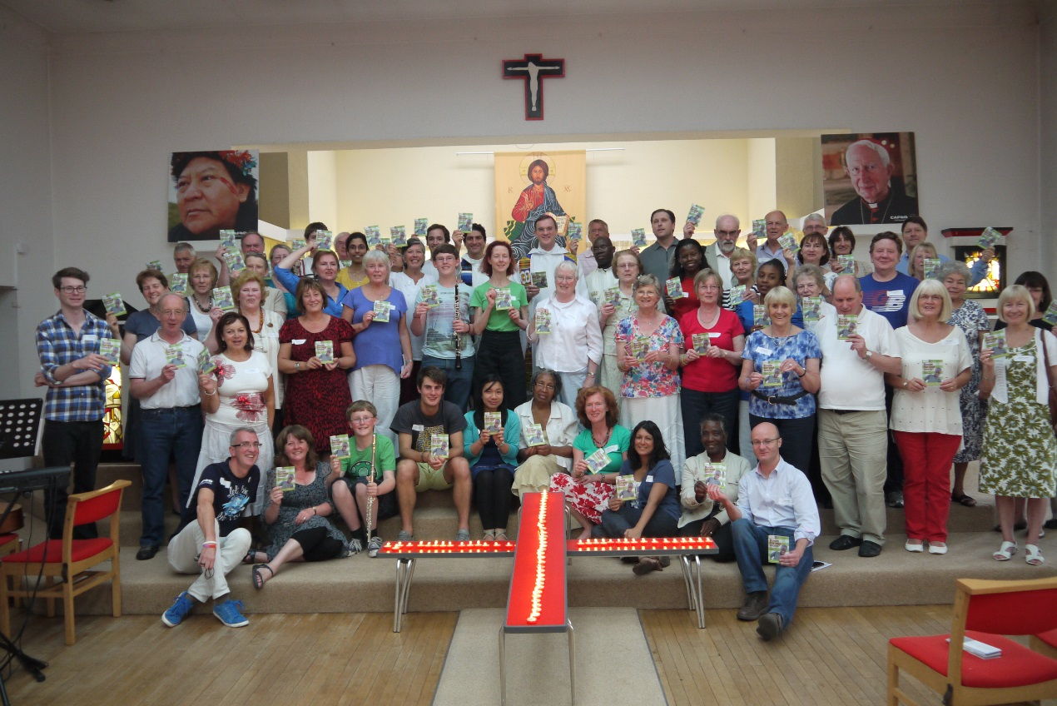
Joint Action
Notes:
Both our Partners and the Pope, have emphasised the need for joint actions.
The pope emphases collaborative understanding of promoting development applies to all relationships, from inter-personal to national and international.
It also implies that there are different individual and national responsibilities, according to positions of power and what resources are available.
But joint actions cannot forge sustainable development if they are not rooted in an actual dialog process where the voices of the powerless ̶and the cry of the earth ̶are truly heard.
Moreover, shared actions comprise the need to rethink our lifestyles, seeking a simpler way of living and using natural resources wisely.
So, we have looked very briefly at what you see, what Pope Francis sees and what some of CAFOD’s partners see...
Thank you
Right Reverend Bishop John Arnold, CAFOD Chair and Auxiliary Bishop of Westminster, with CAFOD Westminster Volunteers after Mass at the Catholic Church of Christ the King, 29 Bramley Road, London N14 4HE, as part of a Day of Reflection.

Slide 17
Photo Credits
Louise Norton, Ruth Norval, Annie Bungeroth, Ben White
CI/Paul Jeffrey, Cat Cowley, Claudia Torres, Eleanor Church
Susy Brouard, Liam Finn, Kibnesh Chala, Lucasz Cholewiak
Richard Wainwright, Arie Kievit, Tabitha Ross
Caritas Internationalis, Caritas South Sudan,
Simon Rawles, Chris Bain, Gemma Salter, Jon Stricklin-Coutinho

